Slide 1
Energy Efficiency for the Machine (the Gigafactory) that Makes the Machine
March 9, 2018

Slide 2
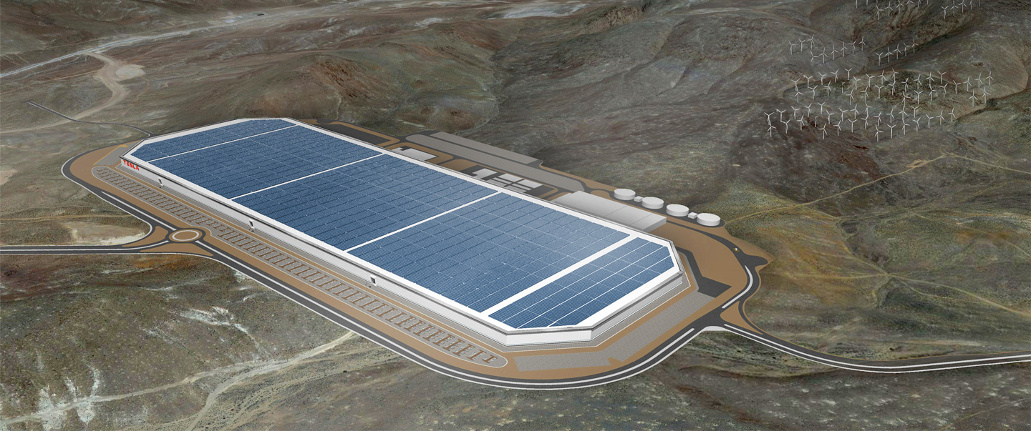
Accelerating the World’s Transition to Sustainable Energy
Energy generation (solar)
Energy storage (batteries)
Energy consumption (vehicles)
GIGAFACTORY 1
30% cheaper batteries enable mass EV production/adoption
Production capability greater than all other global Li-Ion battery production combined
Largest factory in the world (by footprint) when complete
Net zero energy use
Image: tesla.com

Slide 3
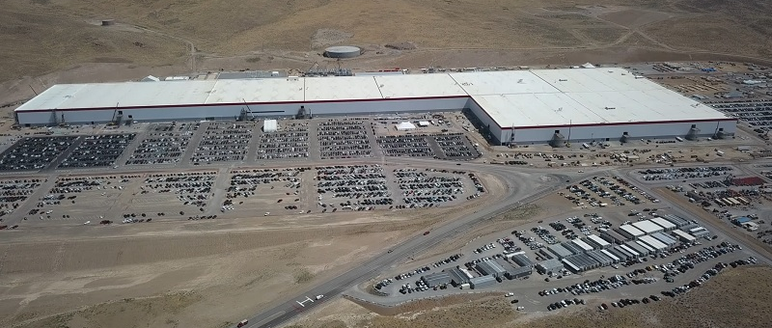
Gigafactory 1 Today
~30% Complete (~5MM sq. ft.)
Simultaneous design, construction, and production
Image: insideevs.com

Slide 4
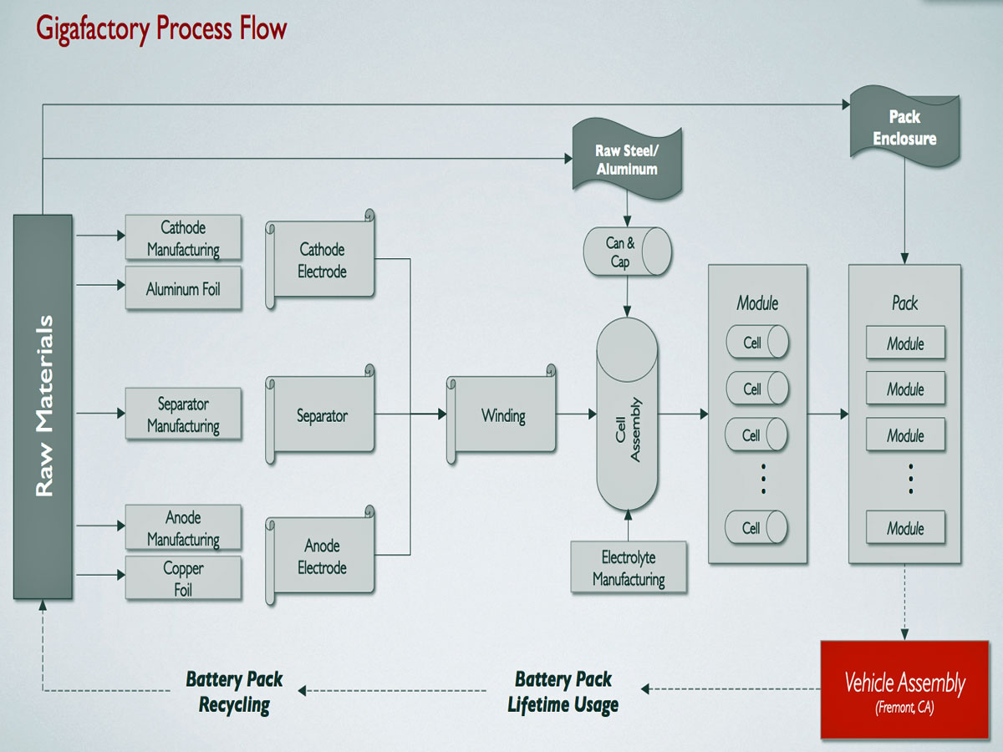
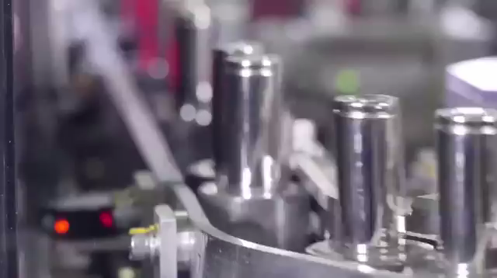
The Battery Manufacturing Process
“The machine that builds the machine”
– Elon Musk
Treating the factory itself as a product
Brings us back to energy efficiency
Image: pintrest.com
Video: youtube.com

Slide 5
Net Zero at Gigafactory 1
Sustainable processes: close the loop on as many flows as possible
  Energy
  Water
  Battery materials (recycling)
Net zero energy difficulties
  Densified production
  Limited roof/ground area
Reduce usage through efficiency
  Tool redesign
  Utility redesign

Slide 6
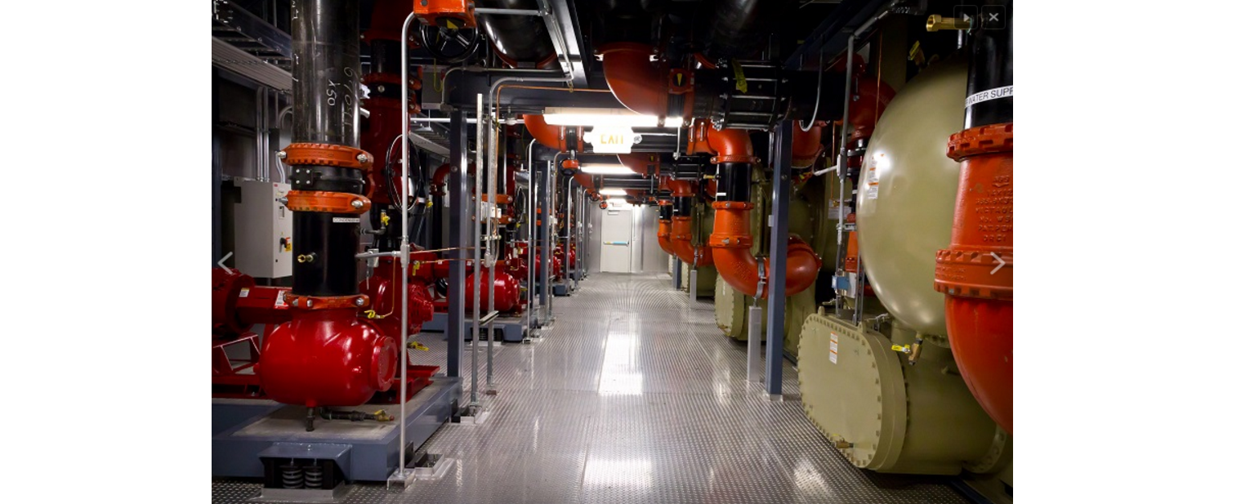
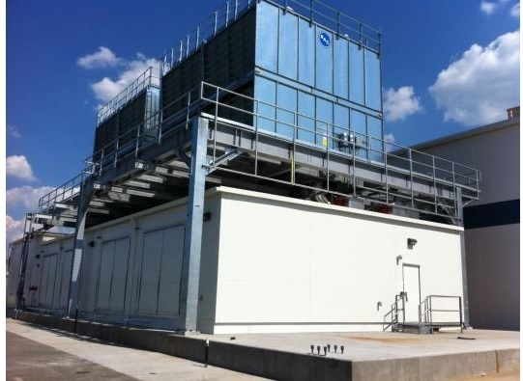
Typical Chilled Water Plants
Chilled water pumped into building for cooling
Water heats up as it absorbs heat (air conditioning, process cooling)
Chillers cool warm water coming from the factory
  High electric power consumption
Cooling towers reject factory heat plus heat generated in chillers to the environment
  Electric power consumption plus high water consumption
Chillers must have sufficient capacity to meet peak cooling demand
  Chillers are underutilized most of the year
Notes:
Power consumption: compressors > fans > pumps

Slide 7
Capitalizing on Reno’s Climate
Reno has dry weather
  Can use wet cooling towers to generate cold water instead of chillers (wet economizing)
Reno has cold weather
  Can use dry cooling towers to generate cold water (dry economizing)
Reno has big daily temperature swings
  Nighttime weather can be cool and dry, even in the summer
Mechanical (Chiller) Cooling
Dry Cooling
Partial Mech.
Wet Cooling
Partial Mech.
Dry Cooling
(No chillers)
Wet Cooling
(No chillers)
70% of year, no chiller needed
35% of year, no wet cooling needed

Slide 8
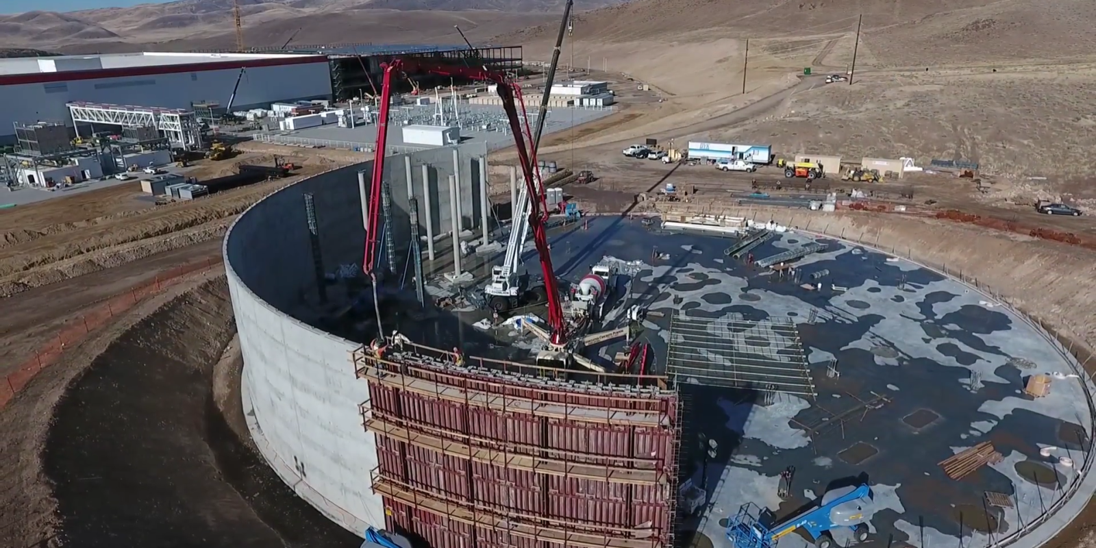
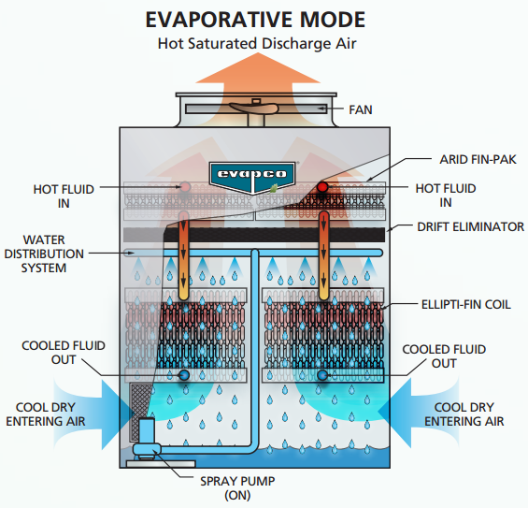
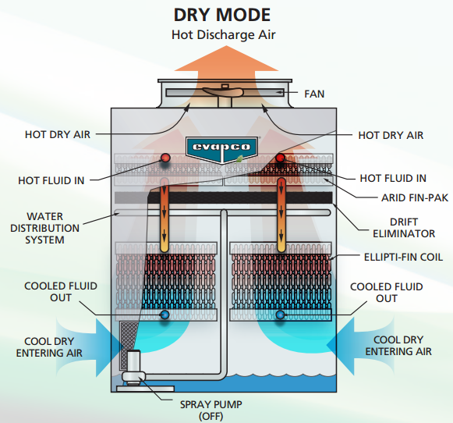
Chilled Water Improvements
Thermal Storage
  Generate cold water at night, use during the day
  Shifts chilled water generation into more favorable hours
Hybrid Cooling Towers
  Same towers can provide evaporative cooling (summer) or dry cooling (winter)
Images: electrek.co
evapco.com

Slide 9
System Improvements
Equipment Ratio
  More cooling tower capacity than chiller capacity
Peak Capacity Adjustments
  Total peak load is higher than chiller capacity
  Managed by TES and towers
Reinforcement Learning Control Algorithm (Future)
  Neural nets estimate loads
  AI can determine control logic and set points
Putting it all together…
Small capital cost savings
Massive water savings
Considerable electricity savings

