Slide 1
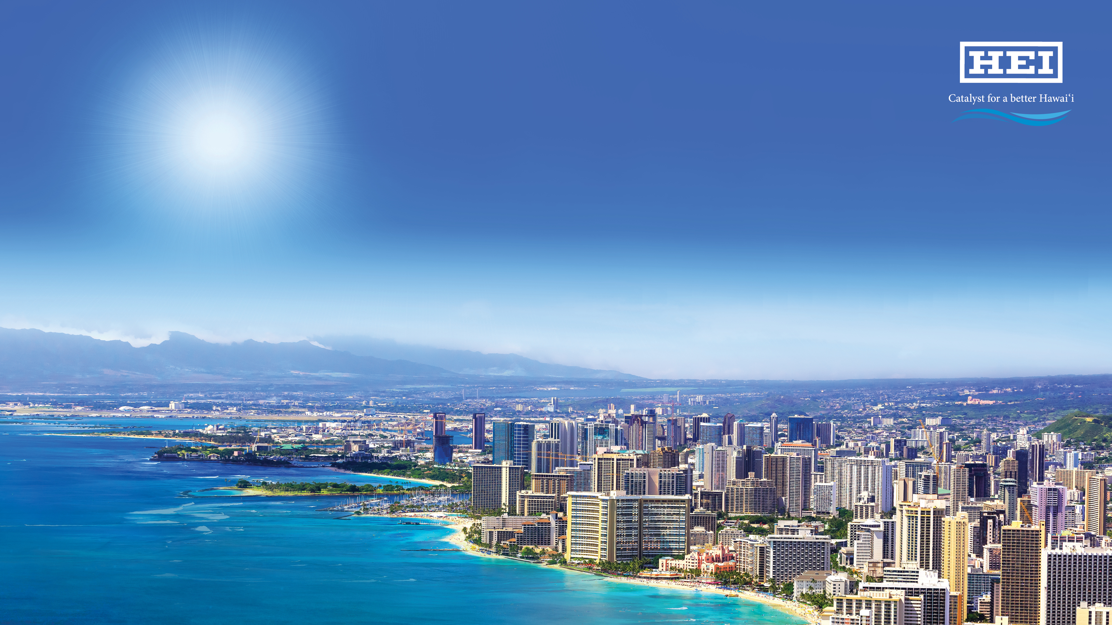
Making Hawaii’s Grid 100% Renewable
Constance H. Lau ‘74
President & CEO
clau@hei.com
Yale Alumni in Energy Conference
March 9, 2018
Notes:
CC

Slide 2

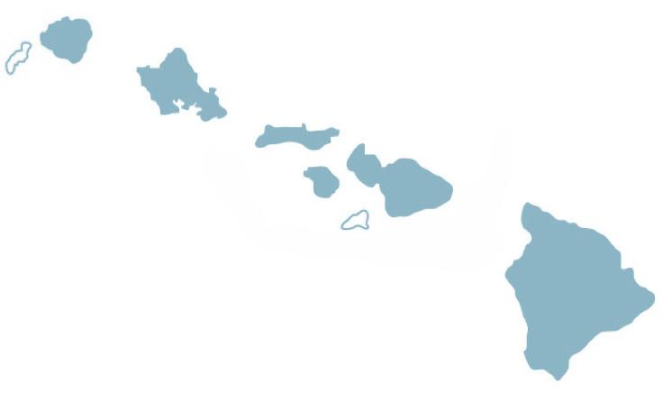


Through our operating subsidiaries, we have a presence on all major islands in Hawaii
Maui Electric
Customers: 71,352
Generating capability: 268 MW
Rate base: $0.45B
Renewable generation¹: 34%
Utility locations
Kauai
3
Oahu
35
Bank branches
Bank branches
Molokai
1
Maui
Hawaiian Electric
Customers: 304,948
Generating capability: 1,222 MW
IPP firm contract power: 457 MW
Rate Base: $2.03B
Renewable generation¹: 21%
6
Lanai
Project locations
Hawaii
5
1
Hawaii Electric Light
Customers: 85,925
Generating capability: 182 MW
IPP firm contract power: 95 MW
Rate Base: $0.50B
Renewable generation¹: 57%
Note: All data as of 12/31/17 unless otherwise noted
As a percentage of total sales

Slide 3
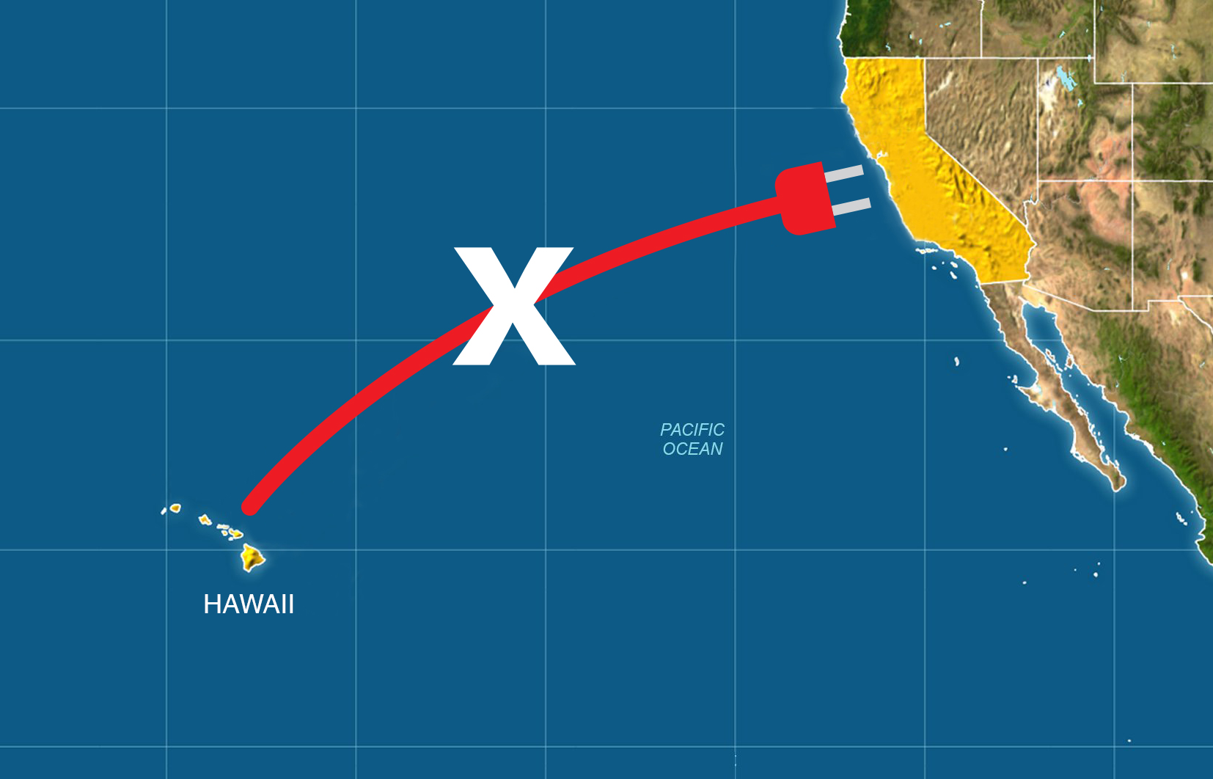

Slide 4
From 40% in 2008 HCEI to 100% in 2015 Law
– 100 percent of electricity sales will come from renewable resources by 2045

Slide 5
National leader in renewable energy integration and distributed generation
Rapid growth of renewables, especially solar
Committed to achieving Hawaii’s 100% renewable goal by 2045
MW
2017 Renewable Portfolio Standard¹
Consolidated | Oahu | Maui County | Hawaii Island
27% | 21% | 34% | 57%
Energized Solar PV | 2008 | 2014 | 2015 | 2016 | 2017
PV Systems | 850 | ~50K | ~60K | ~70K | ~74K
Megawatts | 12 | 389 | 487 | 586 | 695
16% of all customers and 17% of residential customers had installed solar PV as of 4Q17
Renewable energy amounts reflect firm generated and contracted capacity
Renewable Energy incl. Solar includes Net Energy Metering (NEM), Standard Interconnection Agreements (SIA), Feed-in-Tariff (FIT), Purchase Power Agreement (PPA), Smart Power for Schools (SmPS), and utility owned
¹ Electrical energy generated using renewable resources as a percentage of total sales

Slide 6
Progress is being made at a rapid pace
Key PUC decisions issued at increased pace
Entering 2018 with momentum toward renewable goals
Grants Hawaiian Electric’s motion for partial reconsideration of 2017 TY Rate Case interim D&O; interim rates effective 2/16/18
PUC Decisions
Approves demand response management system implementation
Approves implementation of grid modernization strategy
Approves PPAs for 3 solar projects and for biomass plant
Interim D&O in Hawaiian Electric 2017 TY Rate Case
Interim D&O in Hawaii Electric Light 2016 TY Rate Case effective 8/31/17
Approves
new rooftop solar and battery storage programs
Accepts Power Supply Improvement Plan
Authorizes start of process to procure 370 MW of renewables
Approves expanded demand response program portfolio and revised tariff structure
Approves community solar program
2017
2018
July
August
October
December
January
February
Other Developments
Hawaiian Electric files innovative dispatchable renewable PPA
Hawaiian Electric confirms $244 million customer benefit commitment from ERP/EAM¹ project
Hawaiian Electric issues real estate master plan RFP
Hawaiian Electric files final draft RFPs for state’s largest ever renewables procurement
Hawaiian Electric announces 19% increase in solar (distributed and grid-scale) in 2017
Maui Electric files 2018 TY Rate Case
Maui Electric announces PPA for Molokai solar plus battery storage project
Hawaiian Electric files estimated tax reform benefits to flow to customers
¹ Enterprise Resource Planning/Enterprise Asset Management
Notes:
CHL

Slide 7
Key developments in renewables, customer programs
Notes:
CHL

Slide 8
HAWAIIAN ELECTRIC
Planning Principles
Renewable energy is the first option.
The energy transformation must include everyone.
Today’s decisions must not crowd out tomorrow’s breakthroughs.
The power grid needs to be modernized.
The lights have to stay on.
Our plans must address climate change.
There’s no perfect choice.

Slide 9
Power Supply Improvement Plan moves Hawaii even faster toward 100% RE

Slide 10
Key developments in renewables, customer programs
Notes:
CHL

Slide 11
2017 saw continued strong increase in solar, up 19% from 2016
Notes:
3/8/2018

Slide 12
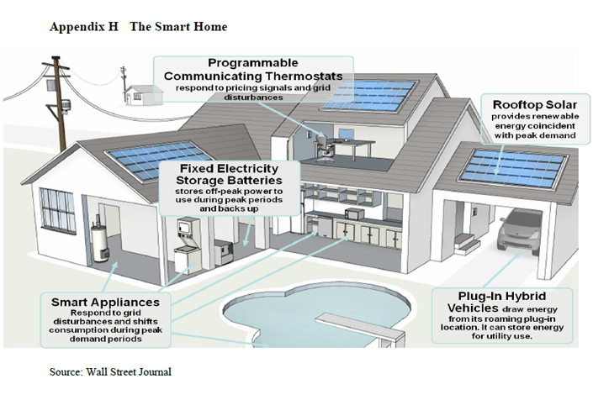
A Power Plant on Every Roof
(and in Every Garage)

Slide 13
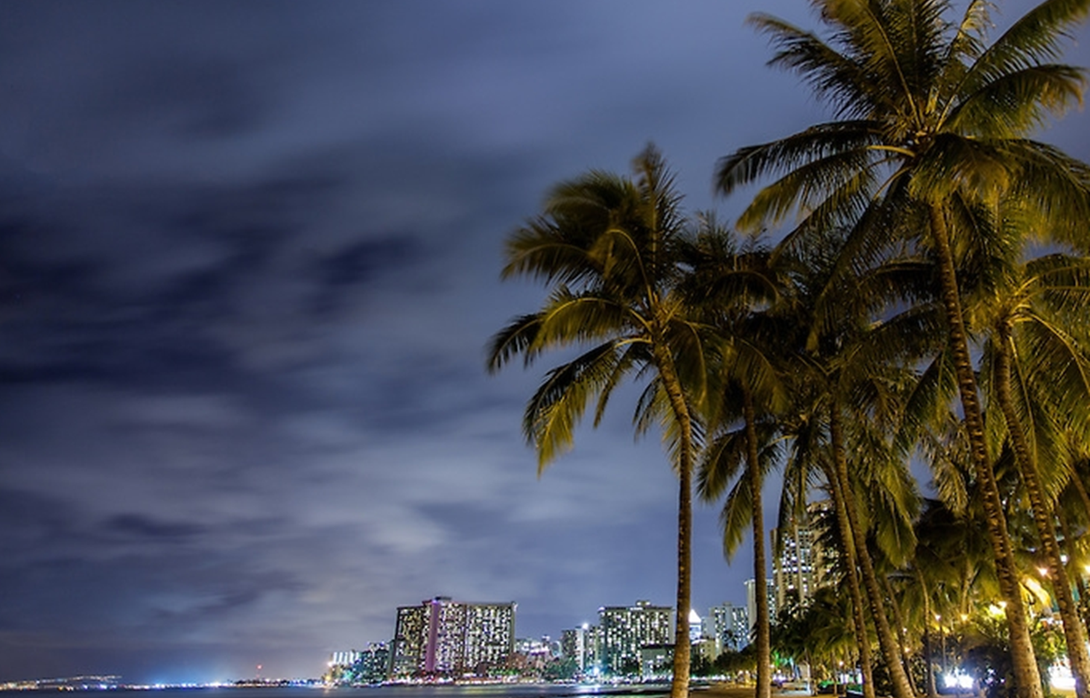
Mahalo
(thank you)
Questions
Constance H. Lau clau@hei.com
President & CEO
Hawaiian Electric Industries, Inc.

Slide 14
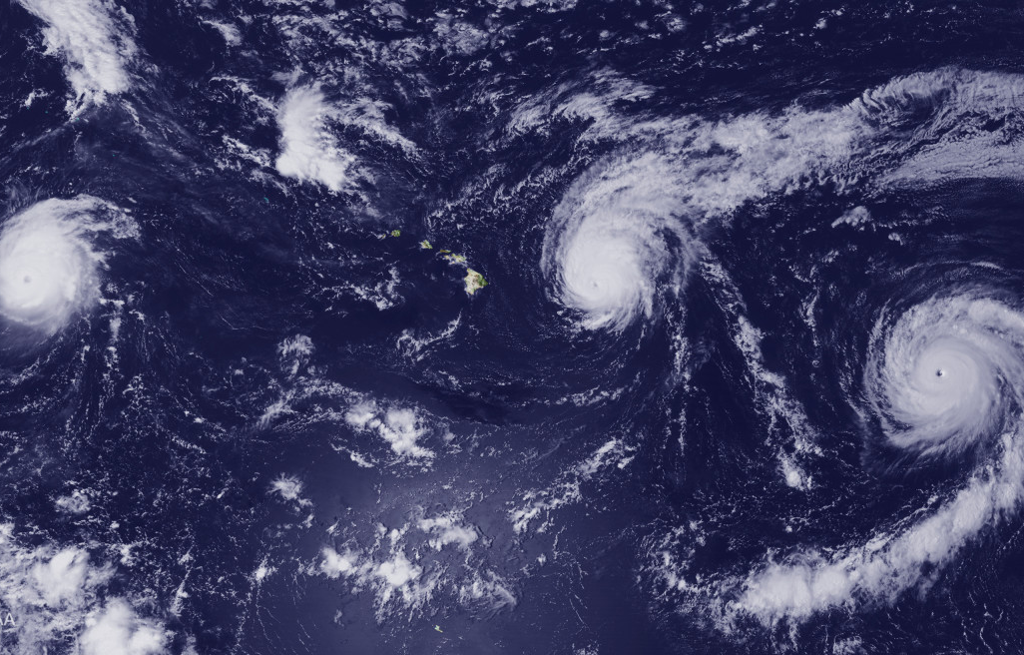
In Hawaii, Resilience is More Than a Buzzword

