Slide 1
Creating staying power
for green energy

Slide 2
Storage Technology Comparisons

Slide 3
Today’s Storage Applications
Frequency and voltage control
Ramping Control
Peak Load Shaving
Removing Intermittency from Renewables (Grid? Storage)

Slide 4
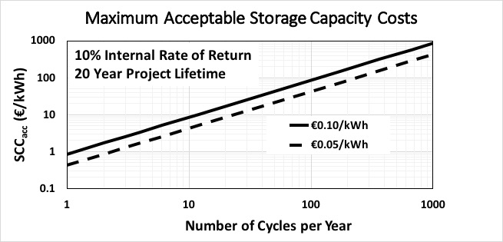
Cap. Cost/kWh Stored

Slide 5
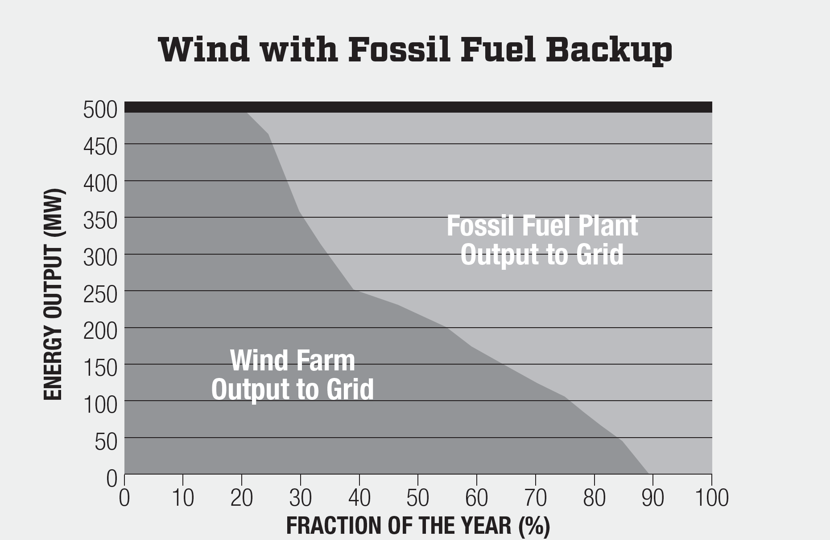
Today Renewable energy requires fossil fuel backup generation
Behind every wind farm is a massive fossil fuel infrastructure to provide backup power when the skies are still.
Wind farms require dispatchable fossil fuel plants of the same output to standby and be ready to generate when wind output falls.
No matter how many wind farms we build, we will never achieve full renewable energy generation from wind without some kind of storage capability that is affordable and clean.

Slide 6
Key Findings in Grid Storage
Massive Amounts of Storage are needed to remove Intermittency
The Number of Cycles per Year is about 3
Today’s Technologies do not work Economically

Slide 7
Hydrogen is the key
The National Renewable Energy Laboratory has stated publicly that hydrogen is the key to deeply de-carbonizing our electric grid.

Slide 8
Hydrogen Storage Technologies
Compressed
Liquefied
Metal Hydrides

Slide 9
Hydrogen Storage Comparisons

Slide 10
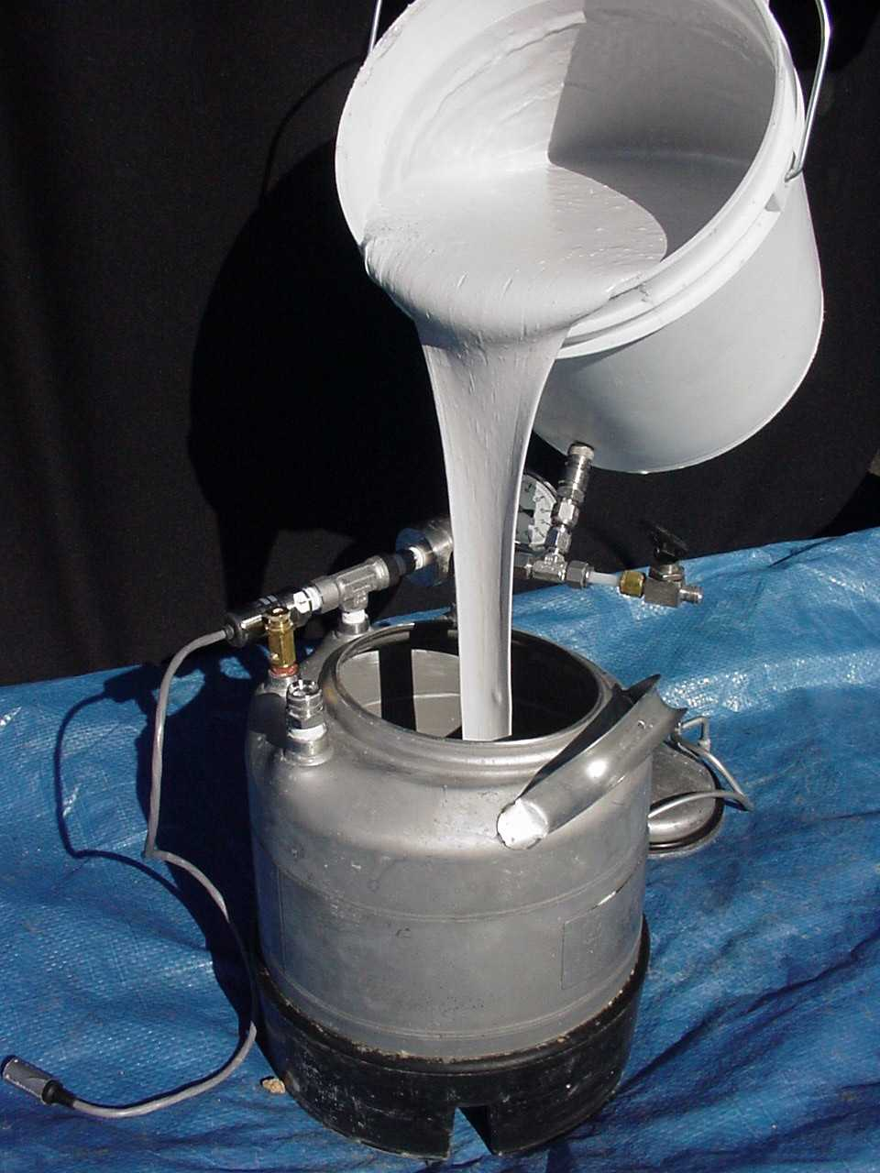
The Slurry
Magnesium particles
Suspended in mineral
oil

Slide 11
The Chemistry
Mg + H₂ ⬄ MgH₂
The reaction is reversible
Pressure drives it to the right
Heat drives it to the left

Slide 12

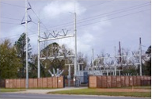
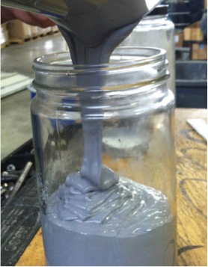
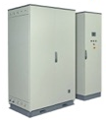
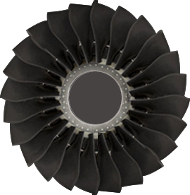
Safe Hydrogen creates two pathways for wind power
Electricity
Electric Distribution
`
Slurry System
Hydrogen Gas Turbine
Electrolyzer
H₂
H₂

Slide 13
Renewables have an intermittency problem
The biggest obstacle to complete replacement of fossil fuel plants by wind farms is intermittency:
  The supply of energy must be constant or dispatchable, even at times of no wind.
Wind farm output is below maximum generation about 80% of the time.
That is why there must be fossil fuel plants to back up wind farms…until now.

Slide 14
The Storage Solution
To create a reliable supply of energy from renewables, some of the energy must be stored for use during times of low output.
With storage, a wind farm can become a dispatchable plant controlled just like a fossil fuel plant
With storage, a wind farm becomes a reliable, constant source of energy

Slide 15
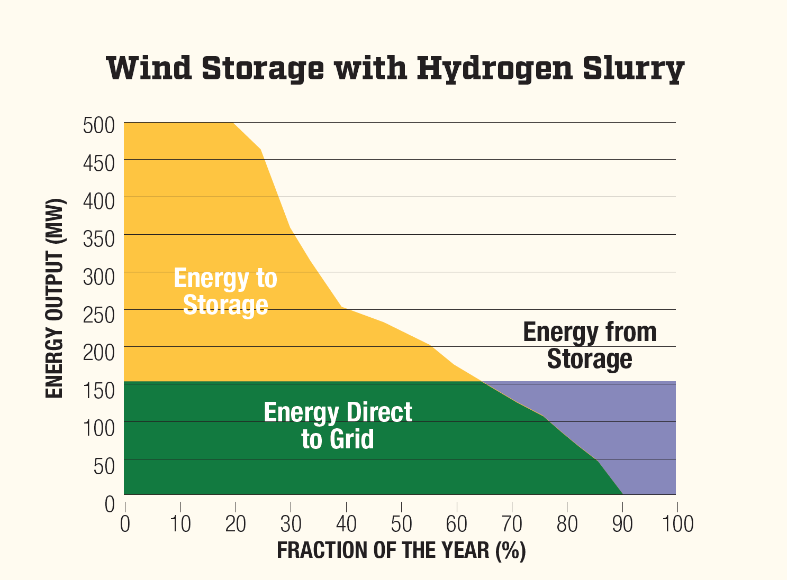
Safe Hydrogen’s solution
Only with Safe Hydrogen can storage become a clean, dependable, economically viable way to eliminate carbon from electricity generation
Safe Hydrogen’s solution will not just capture a large share of the existing need, it will lead to a dramatic growth in the wind power market

Slide 16
Safe Hydrogen’s solution works
The Safe Hydrogen storage system has a much lower capital cost per KWh:
  It is $10 per KWh stored.
  A $800 million wind farm would require a $1 billion storage system, far cheaper than any alternative available today.
  To get a 10% IRR on the total investment including the wind turbines, one would charge consumers approximately $0.10 per KWh, which is approximately the current average price.

Slide 17
IRR vs Contract Price

Slide 18
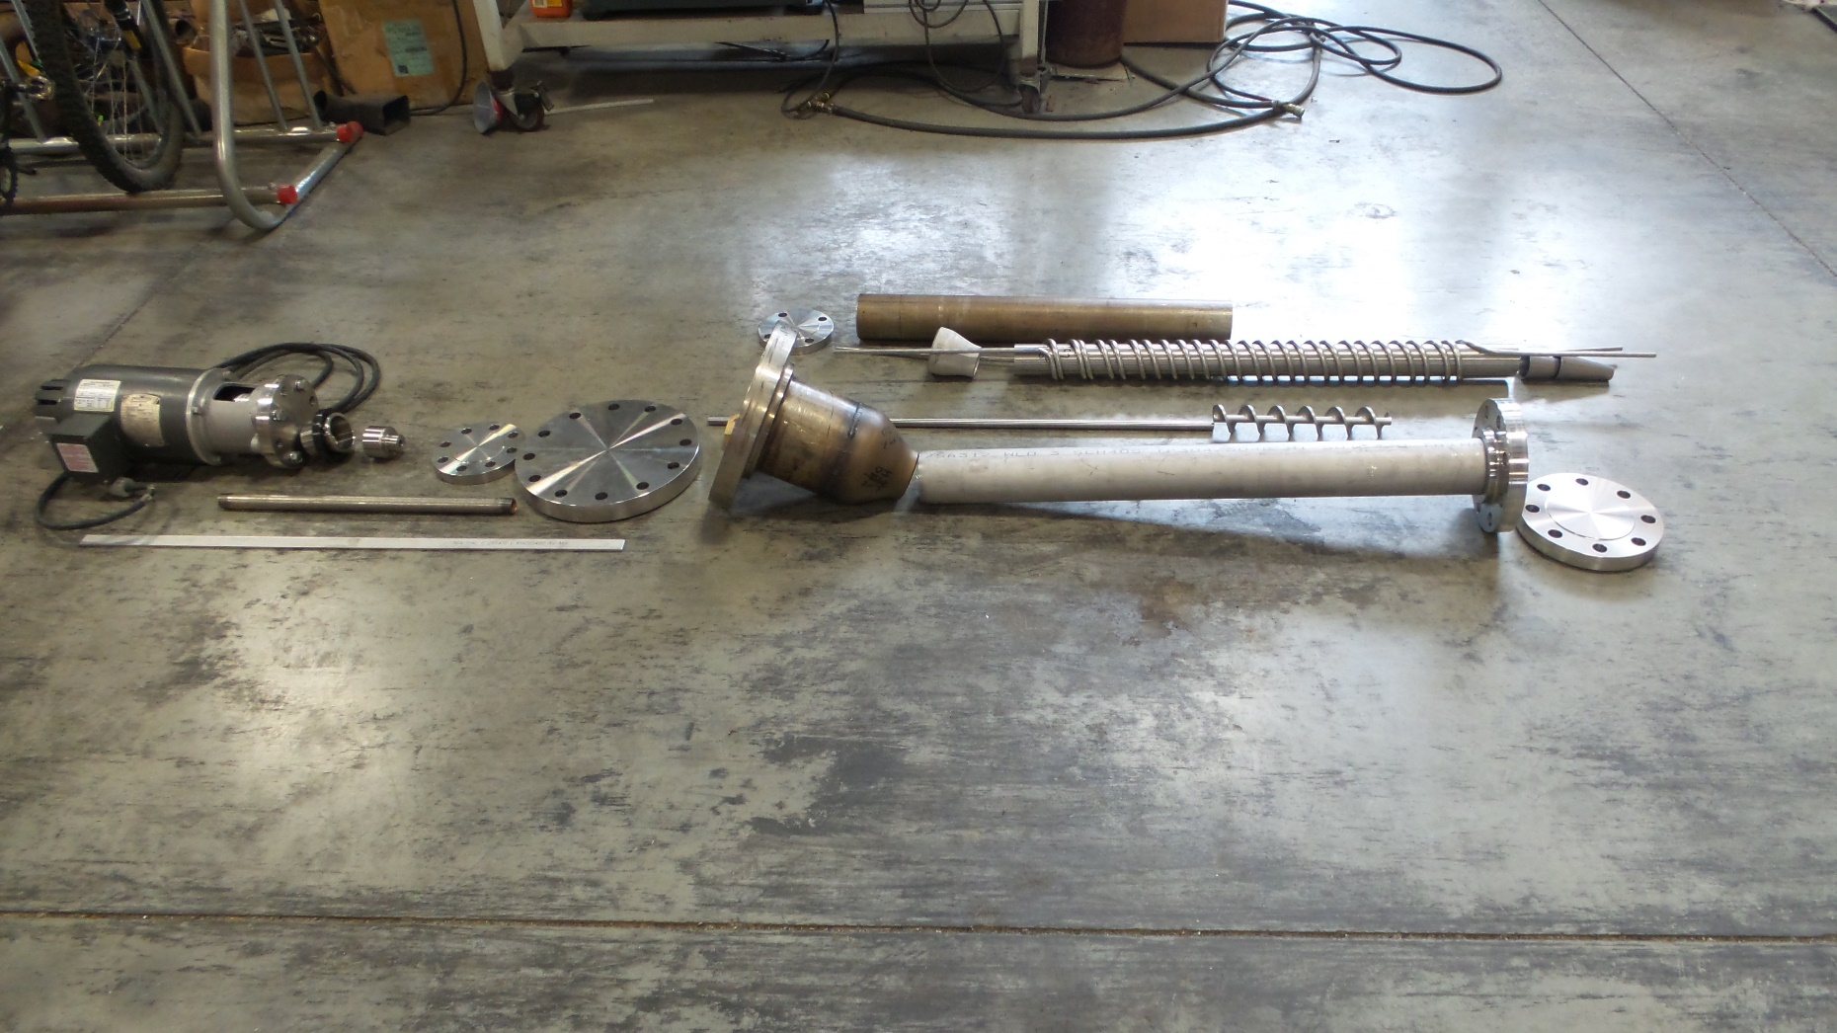
Current Scale up Status: The Pieces

Slide 19
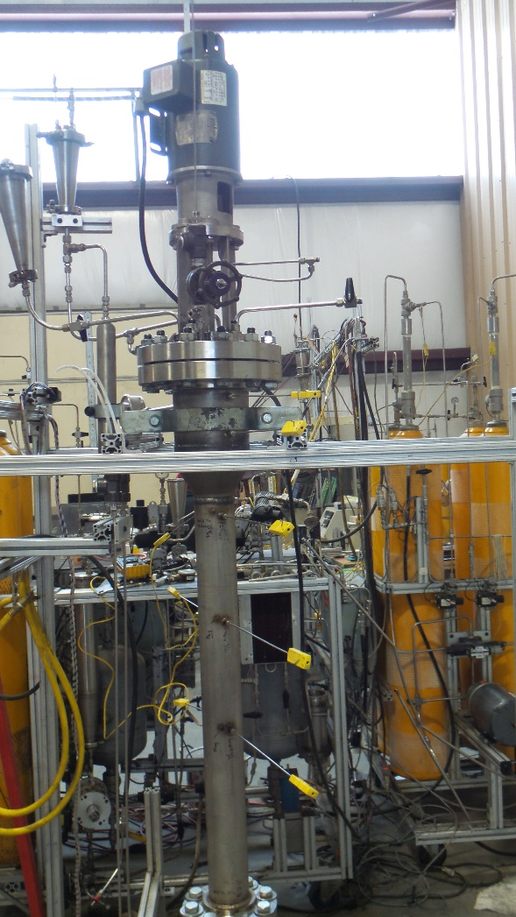
Assembled and Instrumented

Slide 20
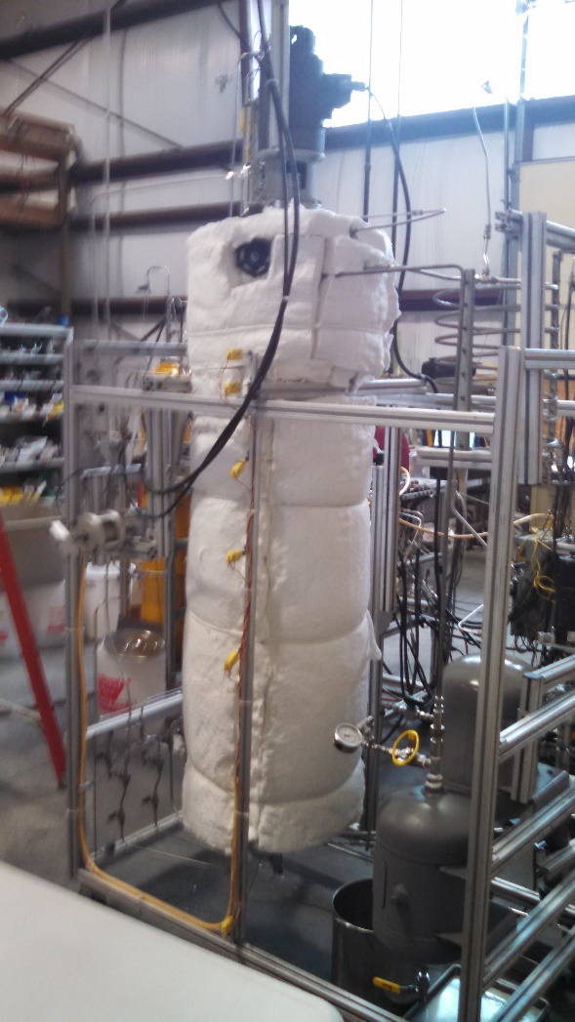
Add Three layers of Insulation

Slide 21
References
Reference 1 - Webinar: H2@Scale: Deeply De-Carbonizing our Energy System, Bryan Pivovar, NREL, July 28, 2016
Reference 2 - Magnesium Hydride Slurry: A Better Answer to Hydrogen Storage, Andrew McClaine, Kenneth Brown, David Bowen, ASME Journal of Energy Resources Technology NOVEMBER 2015, Vol. 137
Reference 3 - Economic top–down evaluation of the costs of energy storages— A simple economic truth in two equations, Christoph Rathgeber, Eberhard Lävemann, Andreas Hauer, Bavarian Center for Applied Energy Research—ZAE Bayern, Walther-Meißner-Str. 6, 85748 Garching, Germany (2015)
Reference 4 – www.safehydrogen.com/technology.html

Slide 22
Contact Information
Ken Brown
Managing Partner, Safe Hydrogen, LLC
781 572 0334
kbrown@safehydrogen.com
www.safehydrogen.com

